Slide 1

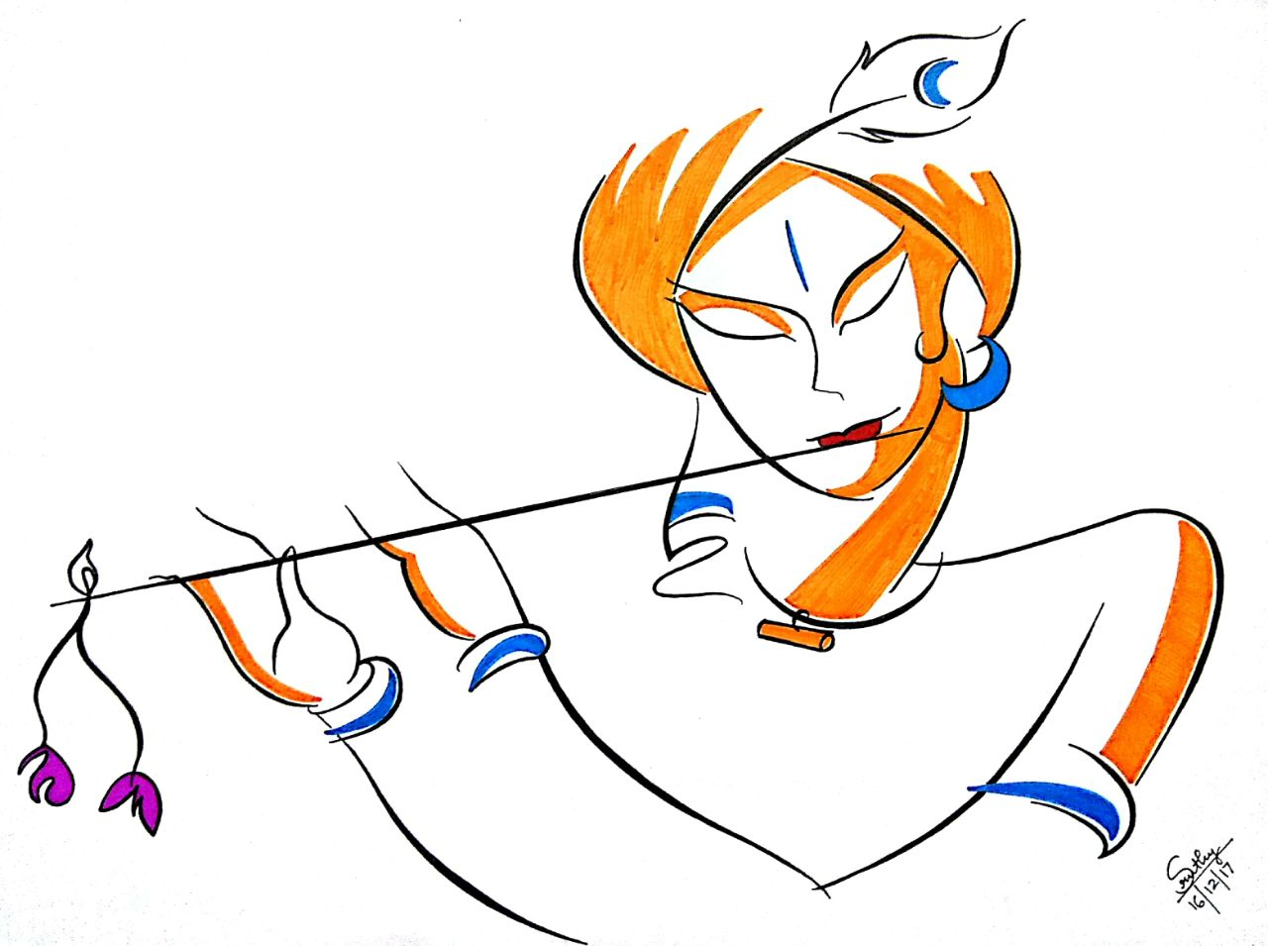


“Self Analytics is
the process of
unraveling the
excellence
within”
The Pattern Institute
invites you to
GiEx 2018
The Gita Intelligence
A Self-Analytics Poster Exhibition based on
The wisdom of Bhagavad-Gita
S M T W T F S S
AUG 12 13 14 15 16 17 18 19
9 am to 9 pm . all days
KRRA 26 -KOLATHERIL ROAD-PETTAH-POONITHURA PO-KOCHI 682038
9˚57’01.00” N 76˚19’48.50” E
vijnan-vikas.org

Slide 2
The Gita Intelligence
‘Produce more than you consume’ has been the mantra for prosperity and growth across ages, more so in the knowledge based economies of the 21st century. Driven by thought-power, the knowledge-based industries of the high technology world that we live in, depend on the creative thinking and productive mindsets of teams and individuals.
Whether you are an entrepreneur, a managing leader, a domain specialist, a parent, a teacher, a student, or anyone faced with tackling problems, be it in your workplace or in the family, meeting challenges head-on and devising strategies to surmount them in an optimal manner is the key. You need to outsmart time, outsmart change, and outsmart competition. Gita Intelligence is about getting ready with such strategies, but doing it in a sustainable, inclusive, and elevating manner, tapping the infinite potential of The Self. Through a process of Self-Analytics, rooted in the eternal wisdom of The Bhagavad-Gita, this poster exhibition on Gita Intelligence brings to you the concepts and strategies outlined in the scripture, in a very practical and rational manner, without being religious and ritualistic, or unduly spiritual.
Reinvent yourself, your teams, your organizations, your students, your family, and your future.
Tap into The Gita Intelligence!
For more details: Phone +91 484 2302497; Cell +91 94468 13556; Email: satishkumar.menon@gmail.com
come, visit us, and partake of the gems of wisdom from our ancient times, projected on the canvas of a modern era
“Inspiration is the Intrinsic
Motivation for
the Joys of the Self”

Slide 3

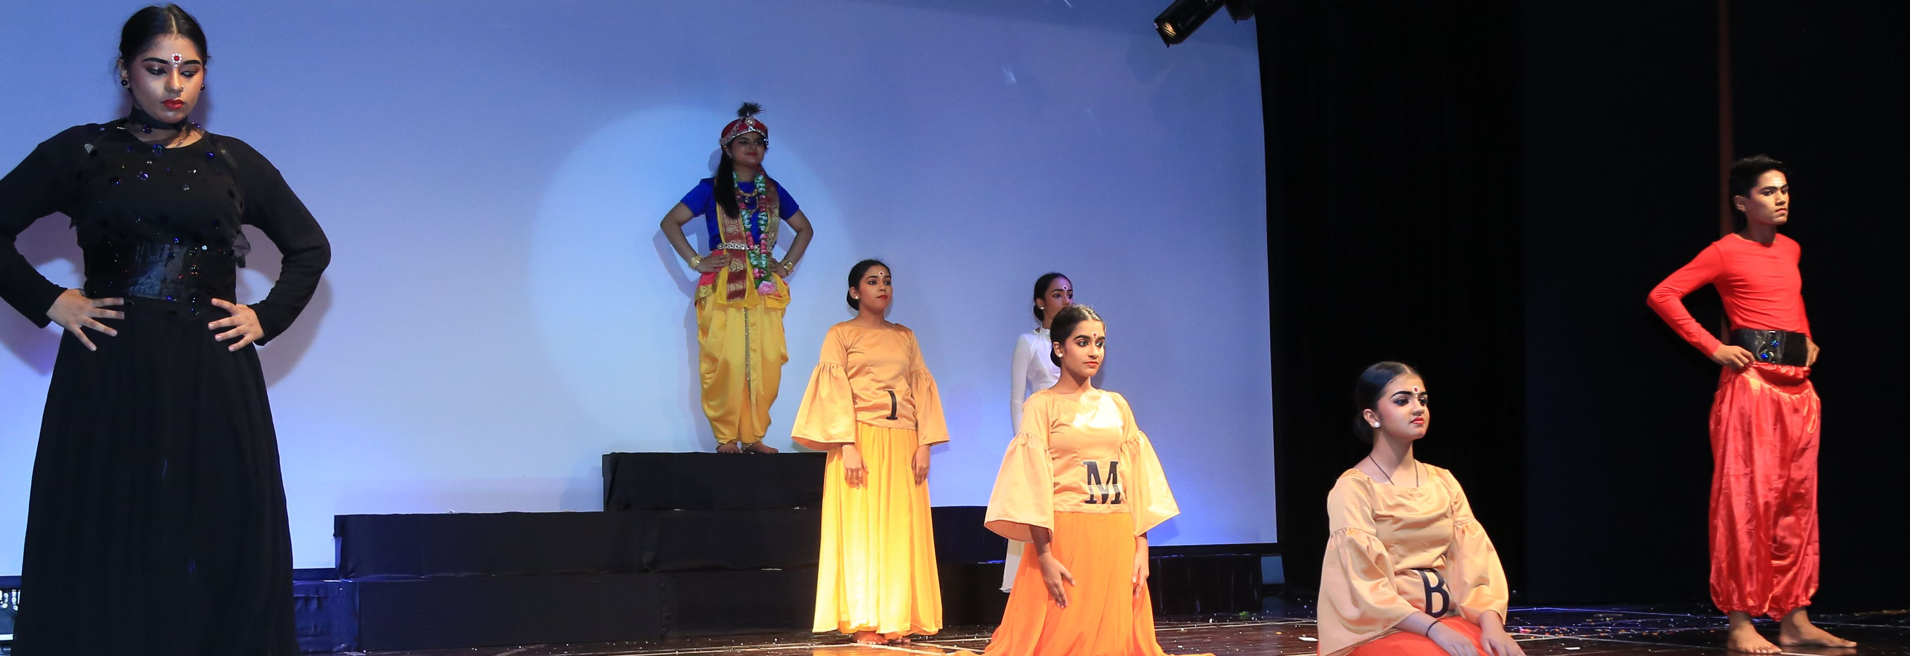
Gita Intelligence for the 21st Century

Special Sessions
12.August.2018
10 AM to 1 PM - Opening session
Gita Intelligence for the 21st Century
14.August.2018
6 PM to 9 PM – Young Minds Session
Motivations, Attitudes and Aptitudes
15.August.2018
10 AM to 5 PM – Fresh Minds Session
Igniting the Infinite
18.August.2018
10 AM to 1 PM – Shaping Minds Session
Teaching, Teacher, and the Taught
19.August.2018
4 PM to 6 PM – Closing Session
From the Limited to the Unlimited
Exhibition will be open from 9 AM to 9 PM on all days

Slide 4





Opening Session
Managers
'manage’!
Leaders
‘inspire’!!
Gita intelligence for the the modern world
Dr. Suvarna Nalappat
Dr. Sulochana Nalappat
Ms. Kairali Narayanan
Ms. Prasanna Varma
Schedule
Fresh Minds
Igniting the Infinite
Ms. Anuradha Nalappat

Shaping Minds
9:00 AM
10:00 AM
11:00 AM
12:00 PM
1:00 PM
2:00 PM
3:00 PM
4:00 PM
5:00 PM
6:00 PM
7:00 PM
8:00 PM
9:00 PM
Teaching, teacher, & The Taught
Ms. Leela Ramamurthy
Ms. Meena Viswanathan
Ms. Lalitha Prasad
Ms. Suma Ravindran
S M T W T F S S
AUG 12 13 14 15 16 17 18 19
Lightning Talks
Infinite to the Finite
On Perception
Self Leadership
The Caste System
3-Step Leadership
Be Inspired at Work!
Gita & Concepts
Brahman-jIva Equality
Non-Agency of Self
Finite to the Infinite
Closing Session
Young Minds
Limited to the Limitless
Mr. Jayachandran Palayil
+Guests from other sessions
Attitudes, & Aptitudes
Prof. N Raman Menon
Mr. S Ananthanarayanan
Video Shows
General
Creation
For Children
The Story of Gita
BG Kids Animation
Inventory Taking
Personal Prakrithi
GI-Score Measure

Slide 5

Gita Intelligence for the 21st Century

Special Sessions
Profile of Guest Speakers
Gita Intelligence for the 21st Century Opening Session: 12 August 2018
Dr. Suvarna Nalapat
Dr. Suvarna Nalapat, is an author, philosopher, poet, educationist, orator, musicologist, and Pathologist. Her other interests are astronomy, literature, archeology, history, psychology and social sciences. Her mother belongs to the Nalapat family, an illustrious family of writers, thinkers, and philosophers. A powerful advocate of the Advaitha philosophy, she explores into the human and cosmic mind, and finds out the harmony in it and gives harmonious music as a panacea for all the illnesses of human race. Dr Nalapat is also a Retired Professor and Head of Department of Pathology in Kerala Govt medical college service, and Amrita Institute of medical sciences, Kochi.
Dr. Sulochana Nalapat
Youngest daughter born to the renowned poetess Nalapat Balamani Amma and V.M Nair- late editor and Managing Director of Mathrubhumi. She worked as a Medical Officer with Tata Finlay in Munnar and with UPASI’s Comprehensive Labor Welfare Scheme. Later she served these Tea Plantations as the Manager of Community Development and Social Welfare Department, for over twenty-five years. She retired from Tata Tea in 1994. Her passion and deep humanitarian bonds brought her to the KDHP company for which she currently works as an advisor. Her literary creations include Jnan Enna Abhavam, Kavadam, Theyila, Daivathinde Nizhal, Swapnadanam, Penayal Thuzhanja Doorangal, Balamani Ammayude Kavithakal (Samaharanam Editing), Manassinakathoru Muri, Munnarinde Katha, Ende Jeshtathi Kamala.
Kairali Narayanan
Holds BA degree in English Honors, Delhi University, and an MA in English from Calicut University. She also has a Diploma in English teaching from CIEFL, Hyderabad. She has taught in several schools and colleges. She has translated several works of writer C Radhakrishnan into English, of which ‘Birds that fly ahead’ received the V. Abdulla award for translation. She is currently active in teaching and literary pursuits. Married to Captain Ravinarayanan Mundayur, she is the daughter of Venmani Vishnu Namboodiri and Devi Vishnu,
Prasanna K Varma
Born and brought up in the cultural hub of Tripunithura she was helplessly sucked into the finer aspects of life in general. A graduate in English Language and Literature she pursued her post-graduation in Applied Psychology. She is interested in many other things except for these two subjects. She has translated Manu S Pillai's best seller work ‘The Ivory Throne’ into Malayalam, is now at translating Yuval Noah Harari's ‘Homo Deus’, in perpetual fear of getting labelled as a translator. She refuses to get stuck.
10 AM to 1 PM
10:00 AM Keynote address by the Distinguished Guests
11:15 AM Discussion
12:00 Noon Gita Intelligence [Strategies]

Slide 6
Gita Intelligence for the 21st Century

Special Sessions
Profile of Guest Speakers
Motivations, Attitudes and Aptitudes Young Minds Session: 14 August 2018
Prof. NR Menon
Is the Founder and Director of Master Coaching Board, a nonprofit-making center for value oriented education, serving the student community for over 50 years. Currently he is also a visiting professor at the School of Business of Amrita University, Kochi campus. Prof. Menon is active in social services like free counselling, food, medicine, and wheelchair distribution. He has also been providing free LLB entrance coaching to students of economically weaker segments in Ernakulam, Trissur, Palakkad, and Alappuzha districts, for the last 19 years. Recently nominated as State President of the Kerala Chapter of the all India organisation, SAKSHAMA, a forum for the Differently-abled. Sakshama started a special school at Thiruvananthapuram and runs a home for the visually challenged at Palghat. Prof. NR Menon was awarded Gandhi Talisman by Kerala High Court in 2014. With a 75% handicap and other limitations, confined from a wheel chair, he has also been discharging duties as the Statutory Member of the National Trust for Mentally Challenged, in Ernakulam district.
S. Ananthanarayanan
He has an undergraduate degree in Electronics Engineering from IIT Chennai, and a Masters in Engineering from Indian Institute of Science (IISc.), Bangalore. He served as a scientist with the DRDO for 40 years, from 1975. Trained from the National Defense College, Delhi, in National Security, he is a Distinguished Scientist and was the Director of Naval Physical Oceanographic laboratory (NPOL), Kochi from 2007 to 2015. Mr. Ananthanarayanan played a significant role in the design and development of Sonar systems for warships and submarines, and in inducting them into service for the Indian navy. His efforts have been instrumental in India becoming self-sufficient in acoustic sensors for warships and submarines. He is the recipient of several national awards.
6 PM to 9 PM
06:00 PM Keynote address by the Distinguished Guests
07:15 PM Discussion
08:00 PM Gita Intelligence [Motivations, Attitudes, Aptitudes]

Slide 7
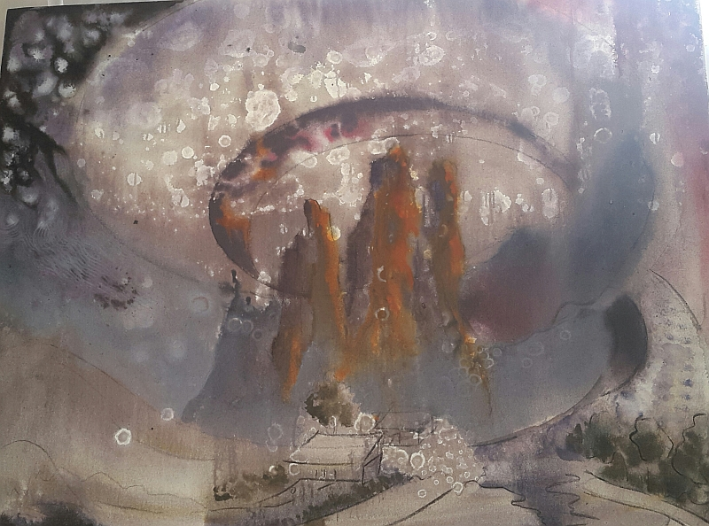
Gita Intelligence for the 21st Century

Special Sessions
Profile of Guest Speakers
Igniting the Infinite Fresh Minds Session: 15 August 2018
Workshop
(full day)
Anuradha Nalapat
Daughter of Sulochana Nalapat and Unnikrishnan Nair, Anuradha Nalapat has published poems in the Sahitya Academy Journal, Indian Literature and other journals and magazines. A book of verse called “Nothing is Safe’ was published by Writer’s workshop. “Her story won the third place in the Unisun-British Council competition-2007. Her poetry and stories are part of anthologies published by Unisun Publications called Mosaic, Curse of the Bird and The Shrinking Women; the South Asian Literary Association-2008 and Many Rooms Many Voices by Katha Lok. The other publications include ‘The little book of Serendipity’, and ‘Nallkavalayile Kuttichathan’ (Short stories). She is a former member of the Lalit Kala Academy and Sahitya Akademi-2006, and a member of Inklinks- a group of women short story writers in Bangalore. First anthology of Inklinks-Bhelpuri-2009. Anuradha also conducts art based workshops for a project called The Stillness Project. She is an artist by profession, passing out of the Fine arts College in Trivandrum and has exhibited her paintings all over India.
10 AM to 1 PM
2 PM to 5 PM
Register before 5-August-2018
Prior registration needed
To participate in the workshop and hands-on activity, prior registration is needed. Students (aged 13 to 18) who are interested must register before 5-August-2018, by citing their date of birth, class in which studying, Institution name, phone numbers to contact, and email ID. They may write to satishkumar.menon@gmail.com. Spot registration requests will not be entertained.
10:00 AM Introduction to Topic
10:15 AM Workshop session, till 1 PM
02:00 PM Workshop/Activity

Slide 8
Gita Intelligence for the 21st Century

Special Sessions
Profile of Guest Speakers
Teaching, Teacher, and the Taught Shaping Minds Session: 18 August 2018
Lalitha Prasad
Has over 32 years of experience as an Educator having worked with various schools under the CBSE system from 1975 onwards. Her specific experiences include 10 years of teacher of Social Sciences and Geography at the secondary and senior secondary levels at the Bhavan's Vidya Mandir, Elamakkara, Kochi and as Vice-Principal and Principal at the same school. She then worked with the Vidyodaya School at Kochi as its Principal for 12 years. She has also worked at the Indian School Al Wadi Al Kabir at Muscat for 5 years as the Vice Principal, before joining the Sai Vidya Vihar at Alwaye as its Principal. She has attended several national conferences and seminars for teachers and principals as well as organized and conducted many in-house teacher training programmes. She has also travelled widely and studied the various schooling systems around the world. She holds an M.A. and B.Ed. degree in addition to PG Diploma in Child, Adolescent, and Family counselling.
Meena Viswanathan
At present Academic Consultant and Education Officer, Bharatiya Vidya Bhavan (since 2006). She has served as Principal Bhavans Vidya Mandir Elamakkara between1990-2006. She was instrumental in initiating Student Teacher Exchange Programme with school in Kent UK, set up school center for NIOS, Resource Room for Children with Learning Disabilities, and NCC Junior Wing. She has a Bachelor’s degree from Calcutta University and Master’s Degree in History from Kerala University. In addition, she is a B.Ed. from Regional College of Education Mysore as well as holds a PG Diploma in Education Administration. Mrs. Meena Viswanathan has served as member of Affiliation Committee, Nodal Head of Social Science, Head Examiner appointed by CBSE, and served as President of Sahodaya Schools Complex, Kochi. She is a Master Trainer of CCE and trained Principals across Kerala, and at Bhavan schools in Kuwait and Muscat. She is also an active member of the Rotary Club of Cochin East, having served as its President, and as Assistant Governor of Dist. 3201.
10 AM to 1 PM

Slide 9
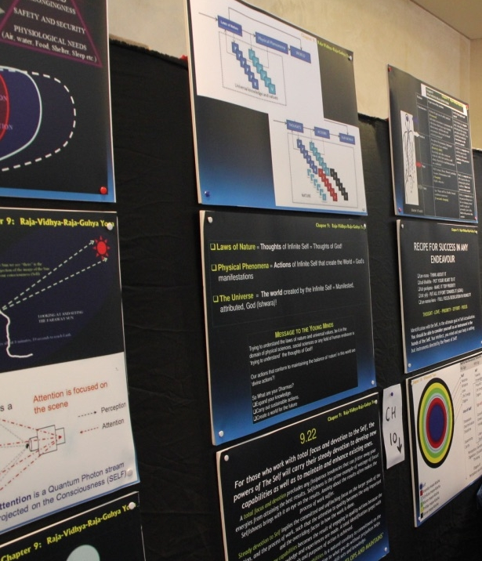
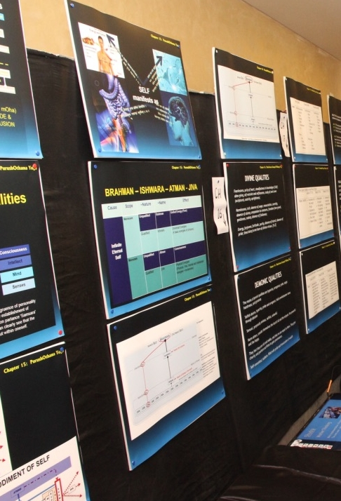
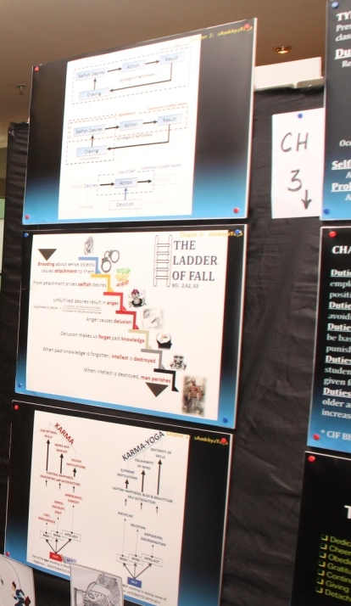
Gita Intelligence for the 21st Century

Special Sessions
Profile of Guest Speakers
Teaching, Teacher, and the Taught Shaping Minds Session: 18 August 2018
Suma Ravindran
Equipped with the academic qualifications of Bachelors in Zoology, and a Masters in Industrial Fisheries, the experience of a home maker, and a PG Diploma in handling learning disabilities which fired her passion to teach children with learning difficulties, she has taught at the resource center in Bhavan’s Vidya Mandir, Elamakkara, Kochi, for 25 years. While dealing with such children, she came across disabilities and difficulties that were caused by behavioral disorders and misguided parenting and soon became proficient at helping both the parents and the children.
From the Finite to the Infinite Concluding Session: 19 August 2018
Jayachandran Palayil
A post graduate in Commerce, he has been a Sales tax practitioner for almost 4 decades, and lives in Pettah Trippunithura. He is a quintessential social worker, and is currently the Secretary of the NSS Karayogam, Pettah.
Prof. NR Menon, & S Ananthanarayanan (for profile see previous pages)
10 AM to 1 PM
10:00 AM Keynote address by the Distinguished Guests
11:15 AM Discussions
12:00 Noon Gita Intelligence [Knowledge Acquisition]
4 PM to 6 PM
Sessions will be moderated by Satish Kumar Menon, Hon. Director, VijnAnVikAs and Pattern Institute.

Slide 10
Gita Intelligence for the 21st Century

Exhibition and Special Sessions
Expected Attendee Profile
The Exhibition [12th August to 19th August]
  Open from 9 AM to 9 PM all days, the exhibition show-cases the central messages of The Bhagavad-Gita in a non-religious context, as a practical tool to unleash your infinite potential. All chapters of The Gita are covered, not necessarily all verses, but the central themes, and philosophies, are highlighted in a practical setting, mapping it with strategies for sustainable, and lasting success and happiness. The general misguided notion that its messages are for the elderly, the posters shall depict a practical approach to success and stardom for the thought-powered. Higher secondary and university students, youngsters embarking on professions, young parents and all those who would like to see the ancient wisdom mapped onto a modern thought-and-work-space are welcome.
Gita Intelligence for the 21st Century [Opening: 10 am to 1 pm on 12th August]
  All those who are interested in taking an under-the-hood view of the insights offered by The Bhagavad-Gita as a life transformation tool. This session shall try and integrate the ancient wisdom with the success strategies advocated for the 21st century thought-powered (Gold-Collar) workplaces. It shall also look at aspects of creativity, productivity, and elevating strategies that are the at the root of stardom at work. This is aimed at all those who are interested in taking a look at Bhagavad-Gita as a life-transformer! Aimed at the thought-powered!!
Motivations, Attitudes and Aptitudes [6 pm to 9 pm on 14th August]
  Creative, productive, and elevating strategies of work, dovetailed with supreme motivations, right set of attitudes, and a pragmatic nurturing of aptitudes paves the way for sustainable, inclusive, and expansive growth and success. This session shall look at these aspects, and integrate it with the wisdom of the ages, in a most practical way. This is aimed at young minds in the age group of 18 to 30. University students, those who have just entered thought-powered workplaces and aspiring professionals and leaders shall benefit.
Igniting the Infinite [Full day 15th August starting 10 am]
  Based on the workshops on Cell & I that artist and writer Anuradha conducts across schools, we shall bring you an artistic experience of systemic expansion of the infinite within. The session is intended for students of 8th to 12th grades.
  Take a look here: https://www.youtube.com/watch?v=xINUtUBv6UU
Teaching, Teacher, and the Taught [10 am to 1 pm on 18th August]
  Aspects of learning, knowledge, the power of teaching, and the intrinsic and extrinsic aspects of a students’ mind-set, are all the different aspects that we shall bring to you in this session, and integrate that with the gems of wisdom that lie spread across the 18 chapters of Bhagavad-Gita. Aimed at Practicing Teachers, and Parents of young minds, this session shall also try and link up some of the emerging knowledge in neuroscience as practical tips.
From the Limited to the Unlimited [4 pm to 6 pm on 19th August]
  The concluding session shall look at the power of expansion that lie hidden in Bhagavad-Gita, as a tool that takes you out of comfort zones, and limitations imposed by your mind-stuff! Aimed at the thought-powered!

Slide 11


Gita Intelligence for the 21st Century
About VijnAnVikAs and The Pattern Institute
VijnAnVikAs Research institute for Self Excellence provides a unique alliance between the imparting of Knowledge for Self Actualization and the dovetailing of Higher Order Value Systems in the pursuit of excellence. VijnAnVikAs started functioning informally in 2003 and was formally registered as a charitable trust in 2012.
The Institute under the VijnAnVikAs Trust is positioned at the intersection of Knowledge and Values acquisition. Our mission is to improve the attitudes and motivations of young generations by instilling in them the ideal of ‘producing more than consuming’ as well as supporting relevant studies and research to integrate scientific knowledge with human values. The institute offers innovative educational services targeted to the needs of the 21st century workplace and the society.
The Pattern Institute is a Research and Development Center of VijnAnVikAs, specifically established to focus on developing the ‘power of thinking’ and ‘strategies for work’ in children and youth.
VijnAnVikAs Trust, Reg. No 715/2012, India
29/2462A|"Krishnaleela"|Kolatheril Road|Pettah, Poonithura Post|Kochi 682038|Kerala, India
Phone: +91 (484) 2302 497| Cell: +91 94468 13556| Email: satishkumar.menon@gmail.com
www.vijnan-vikas.org
Satish Kumar Menon
Has an undergraduate degree in Electrical Engineering from NIT Calicut, Masters in Electronics from DOE, CUSAT, Certifications in Software Engineering from CMU, USA, and Technology Management from Tepper School of Business, CMU. Currently he heads the Operations of the Global R&D center of Esri (USA) in UAE. He was instrumental in setting up and incubating the first global product development unit of Esri in UAE. Previously he was the Software Engineer, Head of Systems Development, and Manager at MAPS, developing intelligent applications in GIS for several government and private sector users in the UAE, other GCC countries, and Northern Africa. Satish initially started his career as a Scientist at DRDO, at NPOL, Kochi where he was part of the team developing intelligent software for Sonars systems. Satish also was awarded certifications in Basic and Advanced Advaita Vedanta, and Bhagavad-Gita, from Chinmaya International Foundation (CIF), and is currently involved in spreading the process of Gita Intelligence among young minds through VijnAnVikAs and Pattern Institute, of which he is the honorary founding Director.
First page courtesy: Mural painting by ViVian Akshaya Balaji, and the Krishna sketch by ViVian Sruthy Raghu

Slide 12
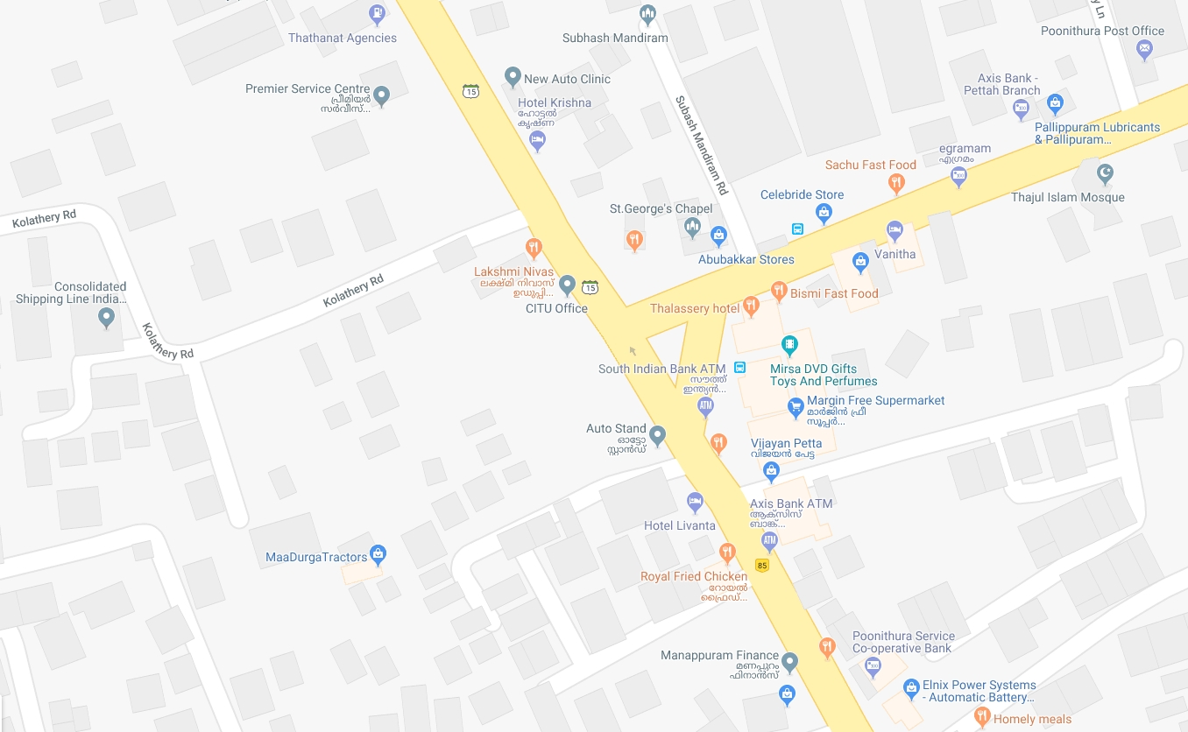



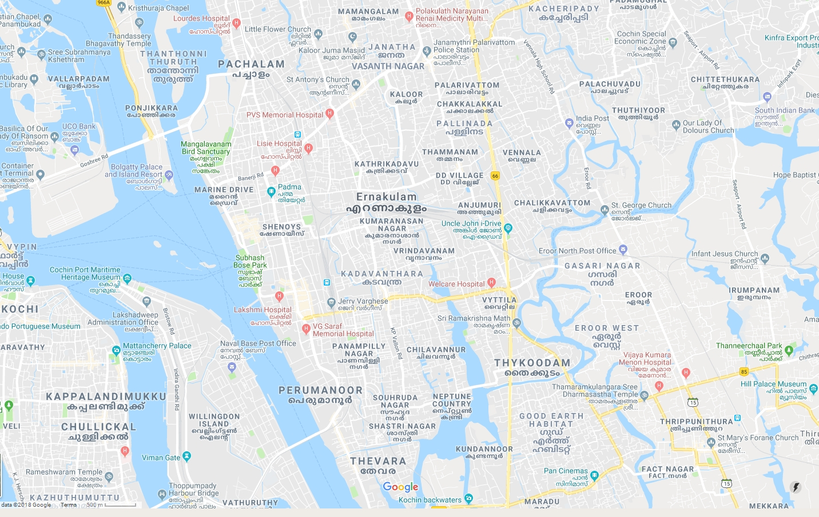
Exhibition Venue
KRRA 26/27
100 meters
Bus Stop
(250 Meters to Venue)
Kolatheril Road
Pettah
Junction
☒ 9˚57’01.00”N 76˚19’48.50”E
29/2462A, “Krishnaleela” (KRRA 26)
Kolatheril Road,
Pettah, Poonithura Post
Kochi – 682038, India
 +91 484 2302497; +91 94468 13556
 satishkumar.menon@gmail.com
Education
is inculcating disciplines of thinking, fortified by supreme motivations and right attitudes.
Pettah

